Slide 1

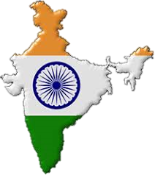

MAPPING SKILLS
(Paper - 1)
For
10th Class
www.digitalsocialteacher.in

Slide 2

MAP DIRECTIONS
North
West
East
South

Slide 3

Lesson
1
INDIA – RELIEF FEATURES

Slide 4

MAP POINTING

Slide 5
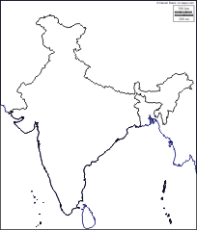
1
LOCATION OF INDIA
3
The north most latitude in degrees (37 6 north latitude)
The south most latitude in degrees
( 8 4 north latitude)
3. The east most longitude in degrees
( 97 25 east longitude)
4
2
4. The west most longitude in degrees
( 68 7 east longitude)

Slide 6
IST
5
5.Indian Standard Meridian
( 82 30 East longitude)
6. The city which is passes Indian standard meridian
(Alahabad)
6
7
7. The city which is passes Indian standard meridian in Andhrapradesh (Kakinada)

Slide 7
BOUNDARIES OF INDIA
8. The Eastern boundary of India ( Bay of Bengal)
9. The Western boundary of India( Arabian sea)
10. The northern boundary of India(Himalayas)
11. The southern boundary of India(Indian ocean)
11
9
8
12

Slide 8
14
MOST POINTS OF INDIA
12. The south most point of India main land ( Kanyakumari)
13. The south most point of India
( Indirapoint)
14. The north most point of India
(Indira col)
15. The East most point of India
( Purvanchal range)
16. The West most point of India
( Ran-off-kuch)
15
16
12
13

Slide 9
MOST STATES OF INDIA
19
17. The Eastern most state in India ( Arunachalpradesh)
18. The Western most state in India ( Gujarat)
19. The Northern most state in India ( Jammu & Kahmir)
20. The Southern most state in India ( Tamilinadu)
17
18
20

Slide 10
21. The place situated on three seas
( kanyakumari-tamilinadu)
22. The strait separating Srilanka from India ( Palk strait)
23. The gulf between Srilanka and India
( Gulf of Manner)
24
25
26
24. The State where sunrise first
( Arunachalpradesh)
25. The State where sunrise last(Gujarat)
26. The prime latitude which is passes through India ( Tropic of cancer-23 30 North latitude)
22
21
23

Slide 11
RELIEF FEATURES
27.Himalayas
28.Indo-gangtic plains
29.Peninsular Plateau
30. Costal Plains
31.Thar Deseart
32.Islands
27
31
28
29
30
30
32
32

Slide 12
HIMALAYAS
36
32. Himadri (Higher Himalayas)
33. Himachal ( Lesser Himalayas)
34. Siwaliks ( Outer Himalayas)
35
32
33
34
35. Highest peak in the world
( Everest )
36. Highest peak in India(K2)

Slide 13
HIMALAYAS
37
38
37. The mountain range where K2 peak situated
( Karakoram Range)
38. The Zaskar range
39. The Patkai Bum (Arunachalpradesh)
40. The Jaintia ( Meghalaya)
41. The Kasi hills(Meghalaya)
39
40
41

Slide 14
HIMALAYAS
43
44
42. Kanchenjunga
43. Nanga Parbat
44. Kulu valley
45. Kangra Valley
45
42

Slide 15
HIMALAYAS
48
49
46. Nainital
47. Raniket
48. Mussori
49. Capital city of Himachalpradesh ( Simla)
47
46

Slide 16
50. The Northern Plains ( The Indo-Gangitic plains)
51. The Indian Plateau ( The Peninsular Plateau)
50
51

Slide 17
PENINSULAR PLATEAU
52. The North division of the Peninsular Plateau ( Malwa Plateau-Central high lands)
52
53. The South division of the Peninsular Plateau( Deccan Plateau)
54
53
54. The River flows in Rift valley ( Narmada)

Slide 18
PENINSULAR PLATEAU
55. The mountain range on the south of Narmada ( Satpura)
56. The mountain range on the North of Narmada ( Vindya)
57. The Plateau Which is rich in minerals ( Chotangapur)
57
56
55

Slide 19
PENINSULAR PLATEAU
58. The Northern boundary of Deccan Plateau ( Satpura Range)
59. The Eastern boundary of Deccan Plateau ( Eastern Ghats)
60. The Western boundary of Deccan Plateau(Western Ghats- Sahayadri )
61. The Southern boundary of Deccan Plateau(Nilagiri Hills)
62. The mountain range which is joint Eastern and Western Ghats
(Nilagiri Hills)
58
59
60
59
61
62

Slide 20
PENINSULAR PLATEAU
63. The Highest peak in Nilagiri Hills
( Dodabetta)
64. The Highest peak in WesternGhats ( Annaimudi)
65. The highest peak in Eastern Ghats(Aroya Konda)
66. The highest peak in South India (Annaimudi)
65
63
66
64

Slide 21
PENINSULAR PLATEAU
67. The Cardamom Hills(Kerala)
68. Palani hills ( Tamilinadu)
69. Rajamahal hills
70. Bundelkand, Bhagelkhand high lands
70
69
68
67

Slide 22
PENINSULAR PLATEAU
71. Ooty( Udakamandalam)
72. Kodaikenal
73. The nearest country of India in water ( Srilanka)
71
72
73

Slide 23
COASTAL PLAINS
74. Gujarat coast (Gujarat)
75. Konkan Coast( Maharasta,Goa)
76. Canara Coast( Karnataka)
77. Malabar Coast ( Kerala)
78. Coramandal Coast ( Tamilinadu)
79. Sircar Coast ( Andhrapradesh)
80. Utkal Coast ( Odisha)
81. Vanga Coast ( West Bengal)
74
81
80
75
79
76
77
78

Slide 24
COASTAL PLAINS
82. The lake in Odissa ( Chilka)
83. The fresh water Lake in Andhrapradesh( Kolleru)
84. The salt water Lake in Andhrapradesh( Pulicat)
82
83
84

Slide 25
THE GREAT DESERT
85. The Great desert in India
( Thar Desert )
86. The mountain range which is caused for Forming Thar Desert
( Aravali Range)
87. The River flowing in Thar desert
( Luni River)
85
86
87

Slide 26
ISLANDS
88. The Islands formed due to volcanic eruption ( Andaman Nicobar Islands)
89. Coral Islands ( Lakshadweep)
90. The nearest country to Lakshadweep
( Maldives)
89
88
90

Slide 27
UNION TERRITORIALS
92
91. National Capital Territorial
( New Delhi)
92. Chandigarh
93. Pondicherry
91
94
95
94. Daiu Daman
95. Dadranagar Haweli
93
96. Andaman Nicobar Islands
97
96
97. Lakshadweep

Slide 28
MAP READING

Slide 29
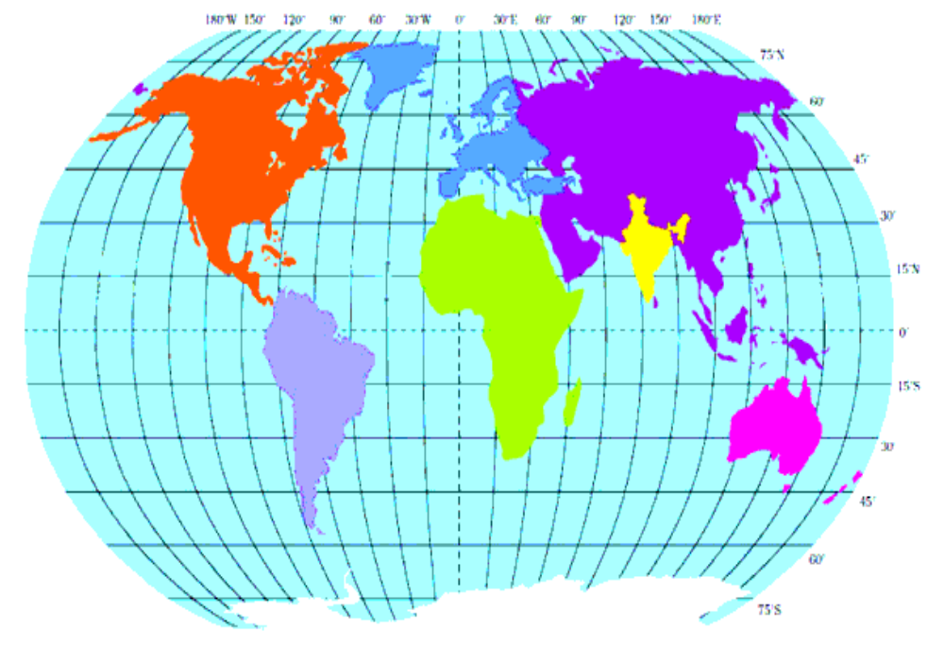
1. Read the following map and answer the below questions.
According to latitudes India
situated in which hemisphere?
Northern hemisphere
2. According to longitudes India
situated in which hemisphere?
Eastern hemisphere

Slide 30
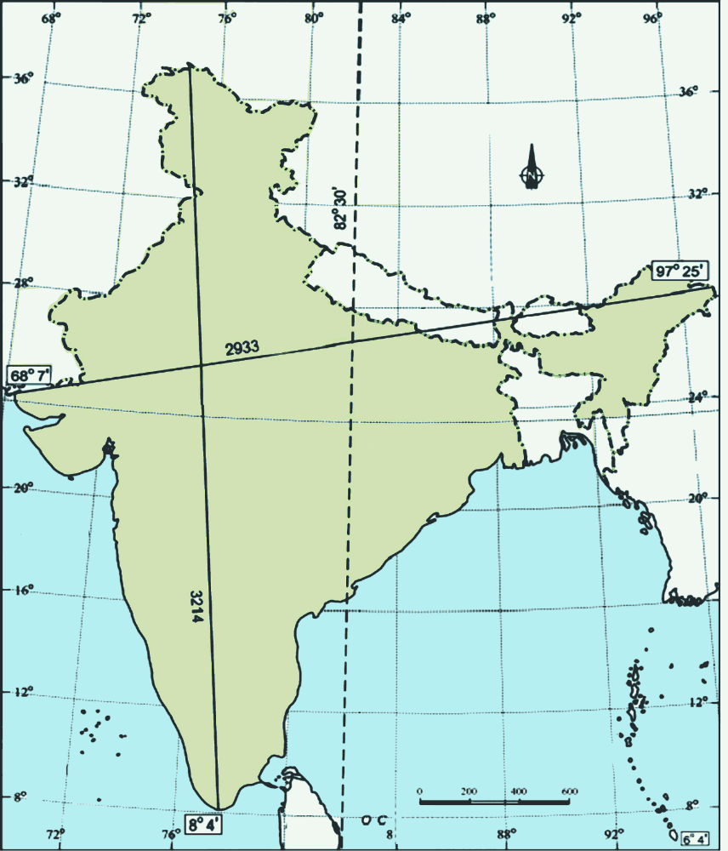
2. Read the following map and answer the below questions.
37 6
1. Which is the south most latitude of India?
8 degrees 4 min North latitude
2. Which is the west most longitude of India?
68 degrees 7 min East longitude
3. Which is the Indian Standard Meridian?
82 degrees 30 min East longitude

Slide 31
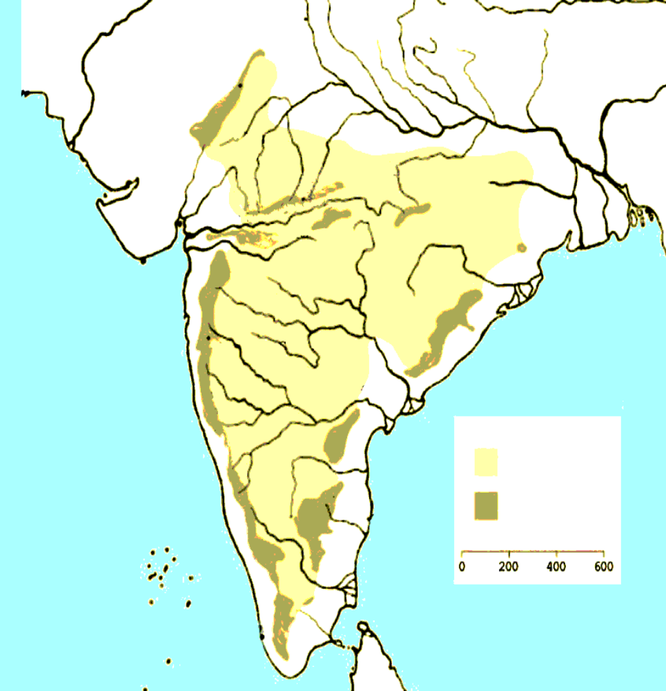
3. Read the following map and answer the below questions.
Which is the eastern boundary of
Deccan plaeau?
Aravali
Eastern Ghats
Vindya
Narmada
Satpura
Chotanagapur
2. Which river flows in rift vally?
Tapati
Narmada
Deccan
Plateau
3. Which mountain range situated in
the North-west part of India ?
Western Ghats
Eastern Ghats
Aravali

Slide 32
Lesson
2
Ideas of Development

Slide 33
IMPORTANT STATES
1
2
The state where Education revolution blowing
( Himachalpradesh)
2. Punjab
3. Bihar
3
4. Kudankulam(Tamilinadu)
4

Slide 34
Neighbour Countries
8
5. Myanmar
6. Bangladesh
7. The Country where Mt Everest Situated ( Nepal)
7
5
6
8. Pakistan
9. The neighbour country
Which has better HDI rank
Than India (Sri Lanka)
9

Slide 35
Lesson
3
Production and Employment

Slide 36
India

Slide 37
Lesson
4
Climate of India

Slide 38
Important Places
1
Leh
Jaipur
Capital city of Tamilinadu(Chennai)
4
2
3
4. Delhi

Slide 39
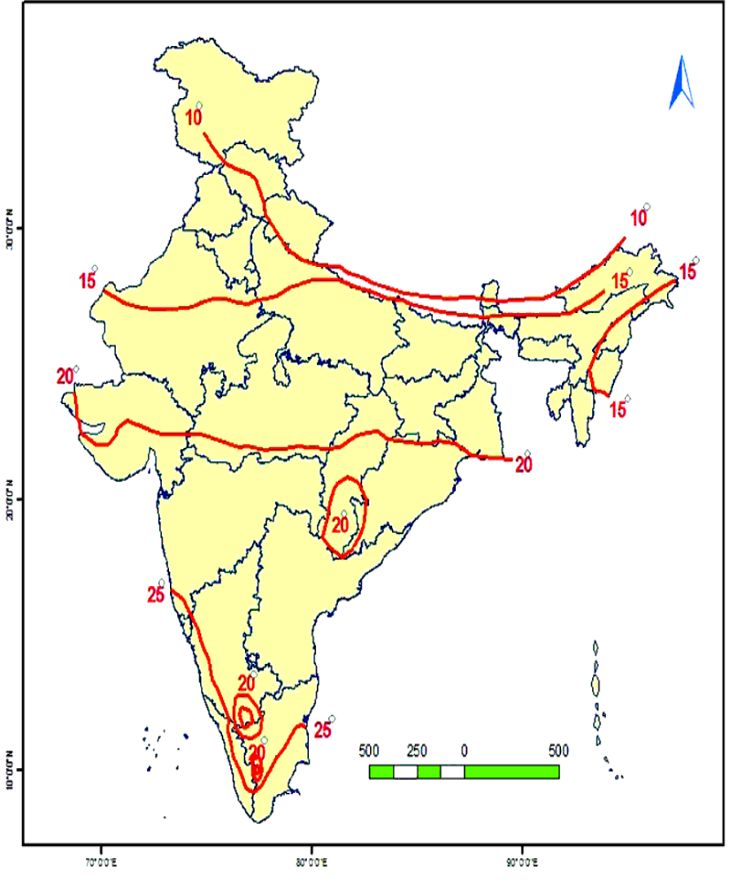
1. Read the following map and answer the below questions.
1.Which states have 10 degree C
average temperature in January?
India Average
Temparature (0C)
January
J&K,Himachalpradesh,Uttarakhand,Sikkim
2.Which states have 20 degree C
average temperature in January?
Gujarat,Madhyapradesh,Chatisghr,Odissa

Slide 40
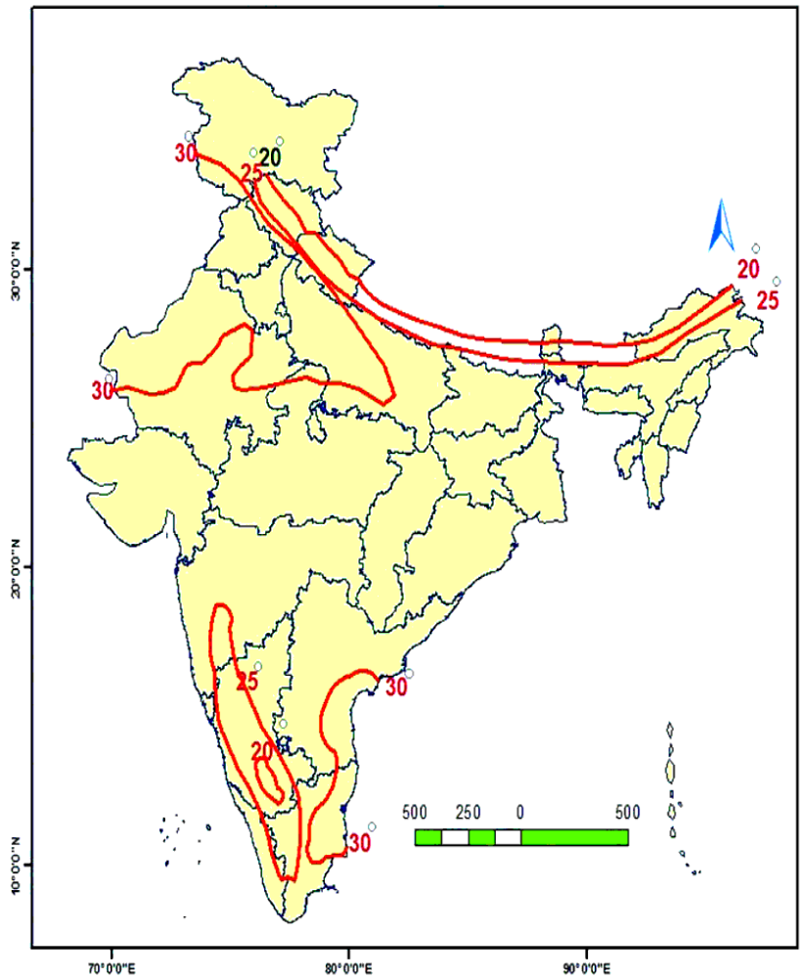
2. Read the following map and answer the below questions.
1.Which states have 30 degree C
average temperature in May?
India Average
Temparature (0C)
in the month of May
Andhrapradesh,Tamilinadu,Rajastan etc.
2.Which states have 25 degree C
average temperature in May?
Himachalpradesh,Uttarakhand,West Bengal,
Arunachalpradesh etc.

Slide 41
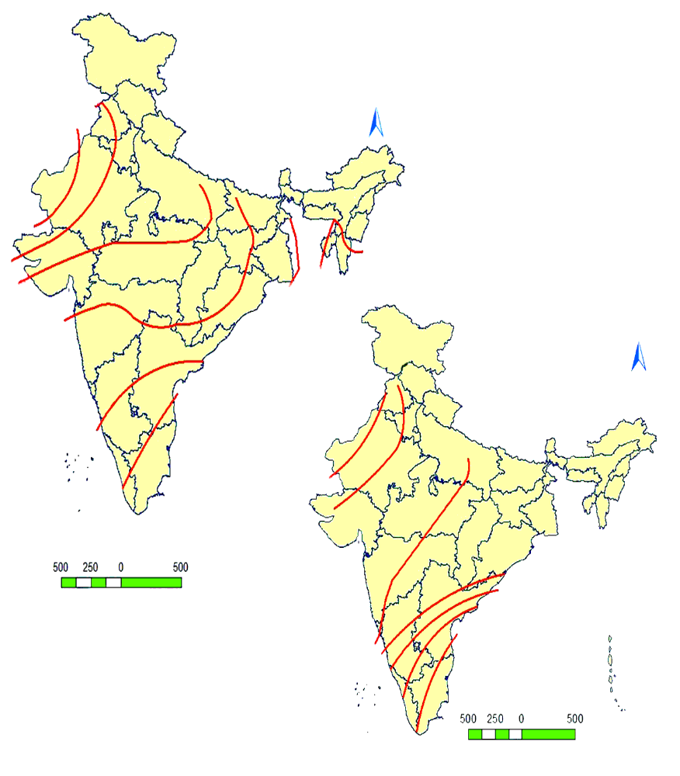
3. Read the following map and answer the below questions.
India - Onset of
south-west monsoon
1.In Which state south-west monsoons
enter first?
1 july
15 july
Kerala
1 june
15 june
5 june
India – Withdrawal
of south-west
monsoon
2.When do the south-west monsoons
Reach Gujarat?
10 june
5 june
June 15th
1 june
1 sep
5 sep
3.In Which state south-west monsoons
enter last?
15 oct
15 nov
1 oct
1 dec
Rajastan

Slide 42
Lesson
5
Indian Rivers and Water Resources

Slide 43
HIMALAYAN RIVERS
1
2
Indus River
Sutlez
Ganges
Bhrahmaputra
4
3

Slide 44
PENINSULAR RIVERS
5. Luni
6. Sabrmati
7. Mahi river
8. Narmada
5
6
7
8
9
9. Tapathi

Slide 45
PENINSULAR RIVERS
10. Kaveri
11. Penna
12. The second longest Peninsular River (Krishna river)
13. Tungabhadra
14. The longest Peninsular River ( Godavari)
15. Mahanadi
15
14
13
12
11
10

Slide 46
IMPORTANT STATES,PLACES
16. Andhrapradesh
17. Kerala
18. Maharasta
19. Uttarapradesh
20. Uttarakhand
21. Madyapradesh
22. Telangana
20
19
21
23
18
22
16
17
23.Hiwarebajar

Slide 47
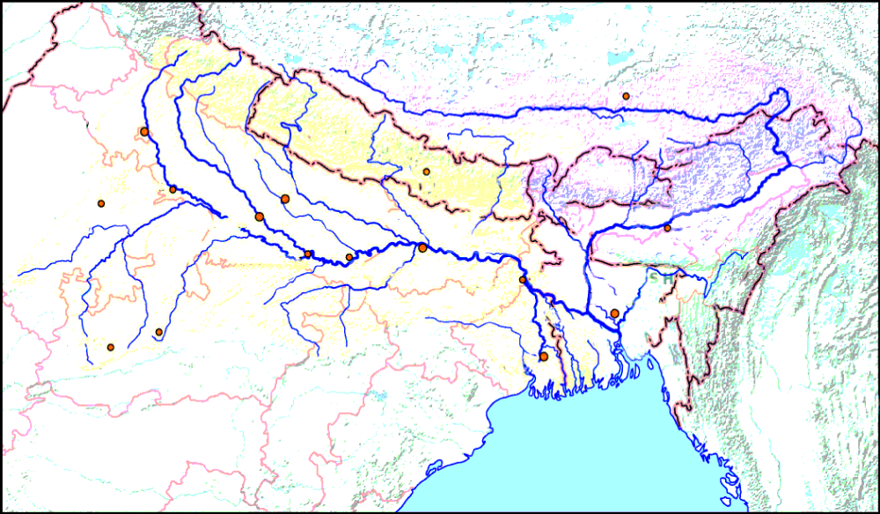
1. Read the following map and answer the below questions.
1.What are north tributaries
Of Ganges?
Yamuna,Gomati,Gandak,
Kosi
yamuna
Ganges
gomati
Gandak
Kosi
Chambal
2.What are south tributaries
Of Ganges?
Betwa
Tamsa
Son
Chambal,Betwa,Tamsa,
Son

Slide 48
Lesson
6
The People

Slide 49
IMPORTANT STATES
Kerala
Haryana
Arunachalpradesh
Bihar
West Begal
Mizoram
2
3
4
5
6
7
1
7. The highest populated city in
Andhrapradesh(Vishakapatnam)

Slide 50
Lesson
7
People and Settlement

Slide 51
MEGA CITIES
2
Mumbai
New Delhi
Kolkata
3
1

Slide 52
METROPOLITAN CITIES
4. Chennai
5. Hyderabad
6. Ahmedabad
6
5
7
4
7. The capital city of Karnataka
( Benglure)

Slide 53
JET AGE CITIES,
important place
8. The city where Indira Gandhi International Airport Situated
( New Delhi)
9. The city where Rajiv Gandhi International Airport Situated(Hyderabad)
8
10
9
10. Barahampur

Slide 54
Lesson
8
People and Migration

Slide 55
IMPORTANT STATES, places
The capital city of Andhrapradesh ( Amaravathi)
Viziawada
9
7
3. Madhyapradesh
4. Manipur
5. Karnataka
6.Chhatisgarh
7. Rajastan
8. Odissa
9. Uttarakhand
4
3
6
8
2
1
5

Slide 56
IMPORTANT STATES, places
10. Tamilinadu
11. West Bengal
12. Jharkhand
13. Nagaland
14. Assam
15. Meghalaya
11
10

Slide 57
Lesson
9 To 12
9. Rampur : A Village Economy
10. Globalisation
11. Food Security
12. Sustainable Development with Equity

Slide 58
Rampur
Uttarapradesh
1
2
3
3. Jalasindh
4. Narmada
4
5
5. Sardhar sarovar dam

Slide 59
Thank You
www.digitalsocialteacher.in

